Slide 1

STOCK PRICE PREDICTION USING LSTM NEURAL NETWORKS AND FBProphet
-AKSHAY KHANNA

Slide 2




WHAT FACTORS IMPACT A COMPANY’S SHARE PRICE ?
Seasonality impacting supply and demand
Substitutes of the product or service impacting the industry revenue
News Articles
Volumes traded in the past
Investor Confidence
Industry Dynamics
Balance Sheet
Income Statement
Cash Flow Statement
Government Policies
Global Events
Macro Economic Factors
Company’s Financials

Slide 3
WHAT FACTORS CAN WE COVER IN OUR WEB APPLICATION ?
Financial Statements
Market News and Sentiment
News articles (Analysis of Financial Advisors)
Past Stock Price Trends
Model the past trend and seasonality patterns to predict long term and short-term price movements
YOY Revenue and Profit %Change
Opening and closing price of stocks in last 10 years
Forecasting Algorithm Predictions

Slide 4


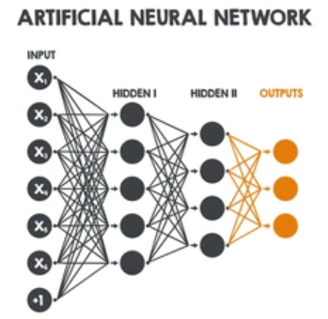





STOCK PRICE PREDICTION APPLICATION
Data Collection APIs
Data Processing
Time Series Forecasting
REST API for 3rd Party Integration
Docker Container
Web Application

Slide 5
Web App Demo

Slide 6
Thank You

